Slide 1

FRONT-END DEVELOPMENT
PROJECTS
Music Venue Site
SUBMITTION BY: -
Indresh Gupta
2010990306
Group:- 19
Branch:- CSE
Batch:- 2020-24

Slide 2
Music Venue Site :-
This project is very basic and very essential one for your venue business, we all know that every year there are thousands of concerts around the world. The fact that it will help you find musical venues around the world. It is an excellent way to get your venues on the list and grow your business.

Slide 3
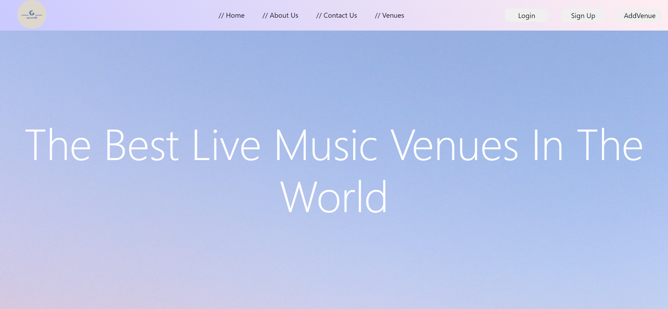
HOME-PAGE:-

Slide 4
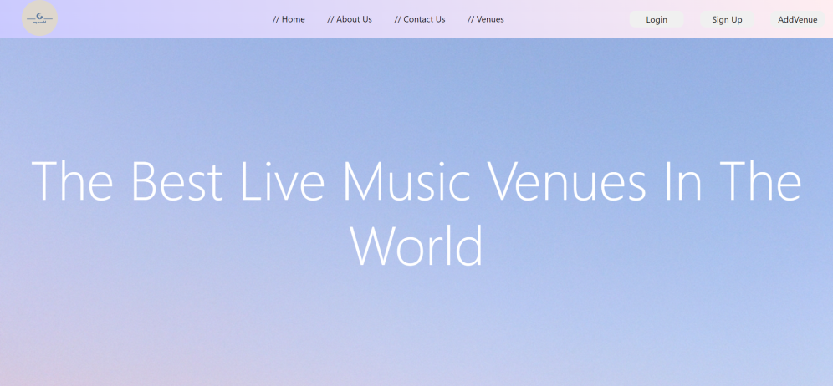
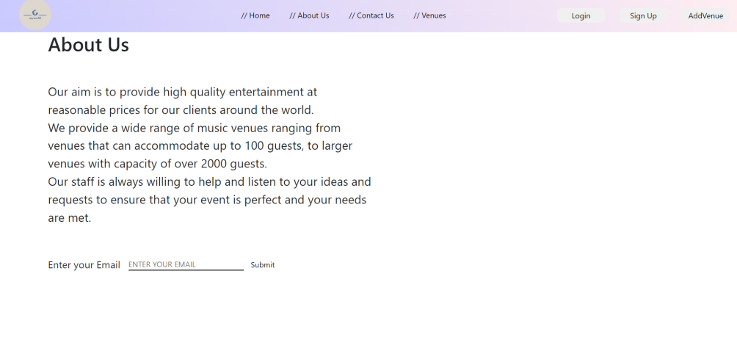
This Website is created using REACT JS Only
This music venue site contain 8 sections :-
Header/Preface/:- This section consists of the navigation bar to access every section of the website.
About Us :- This section is a little introduction of website and what this website is about. Also a good way to get more people on newsletter for updates.

Slide 5
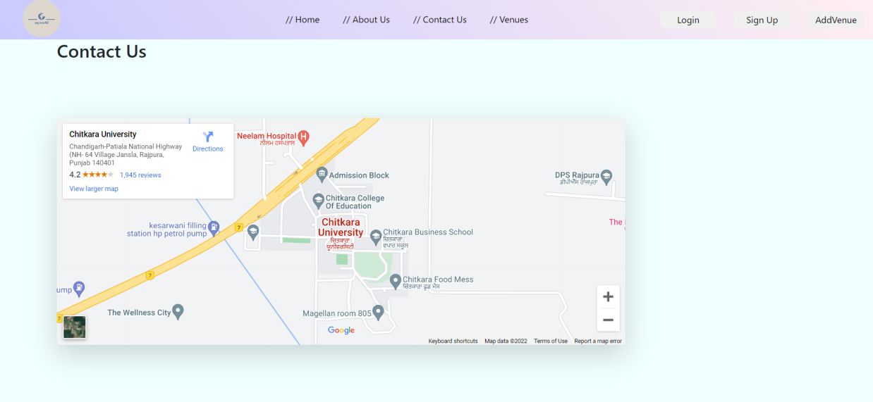
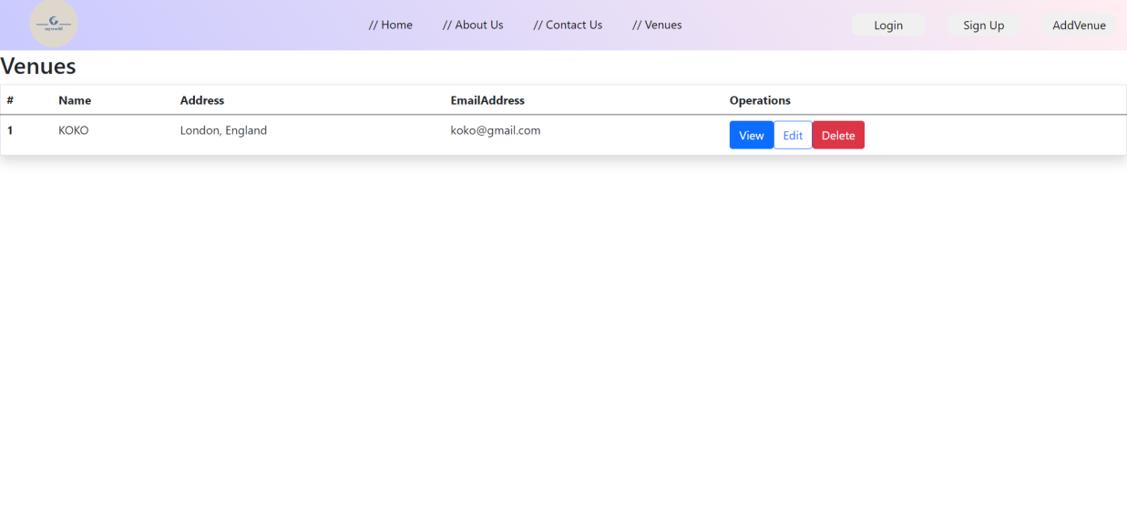
Contact Us:- This section contains a map.
Venues:- This section consist of all the available venues and there images. Data in this page can be edited , viewed , and deleted .

Slide 6
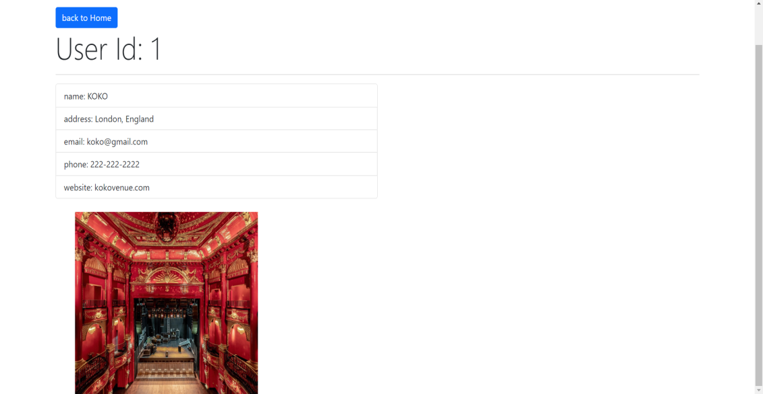
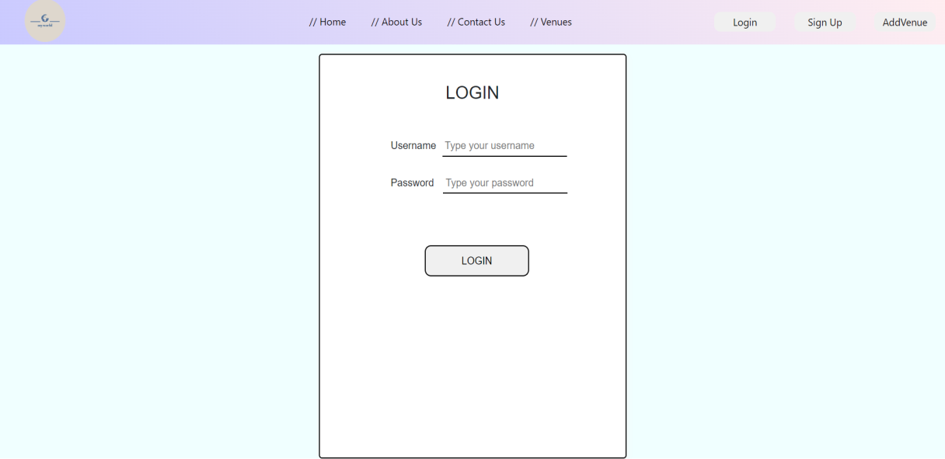
5. View:- This section of website will display various details about the venue and pictures of the venue.
6. Login:- This page is used to log into the website

Slide 7
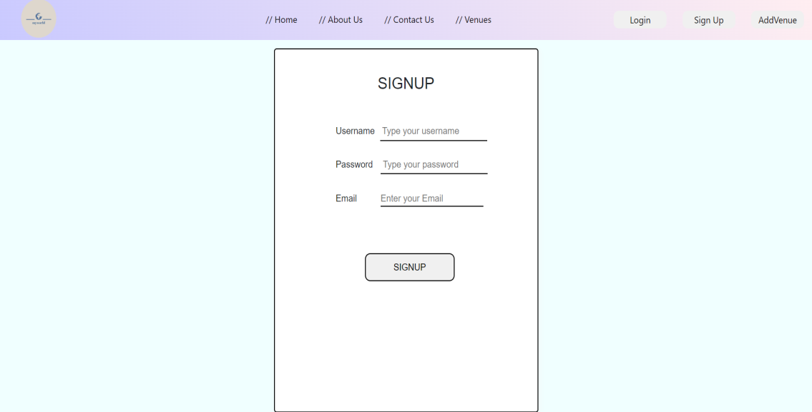
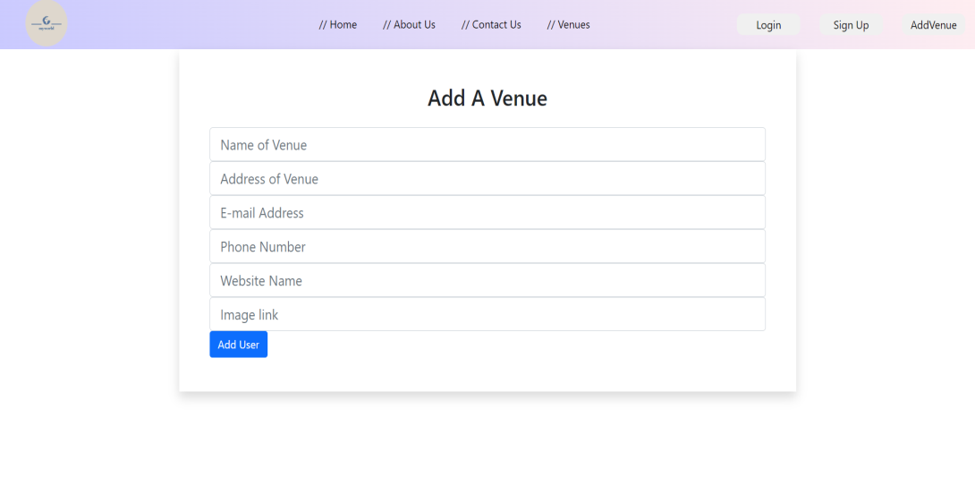
7. Sign Up:- This Section is used to signup for the website.
8. Add Venue:- This section is used to add new available venues in our site.

Slide 8
Code Implementation :-
The implementation of this project contains React JS.
React is used to create interface of this website.
All the eight sections in this website are created using React JS.
Data fetching and updating is done by the help of api.
Backend of this project is implemented by the help of JSON server.

Slide 9
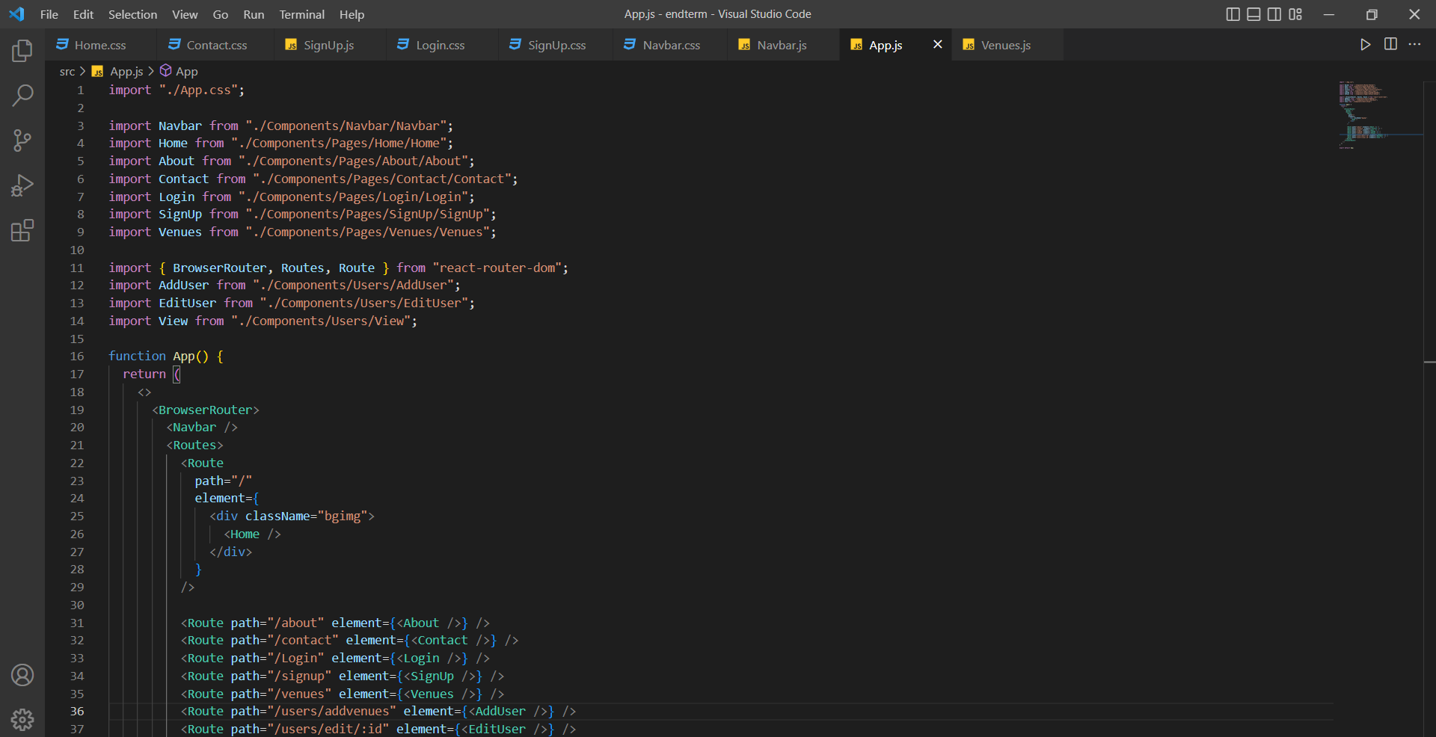
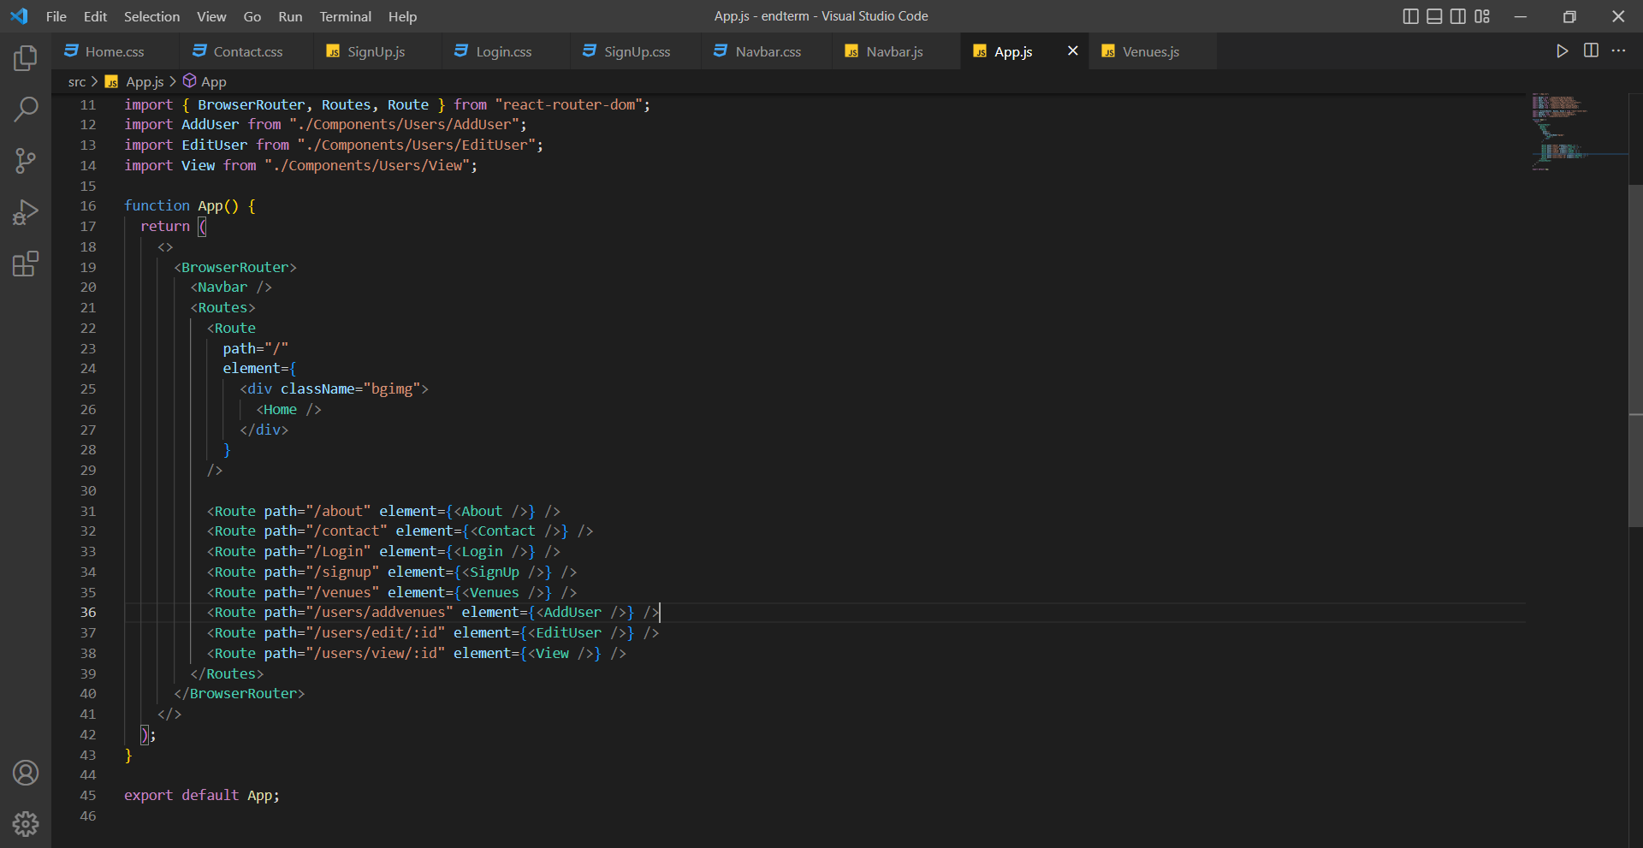
REACT Code Snippet

Slide 10
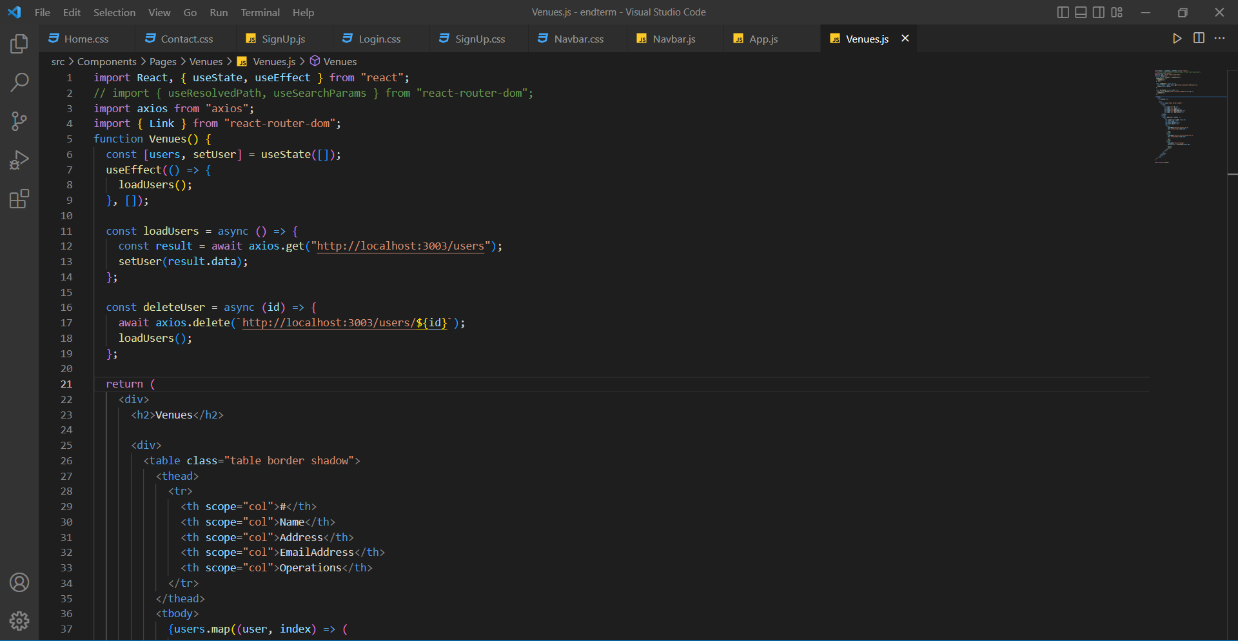
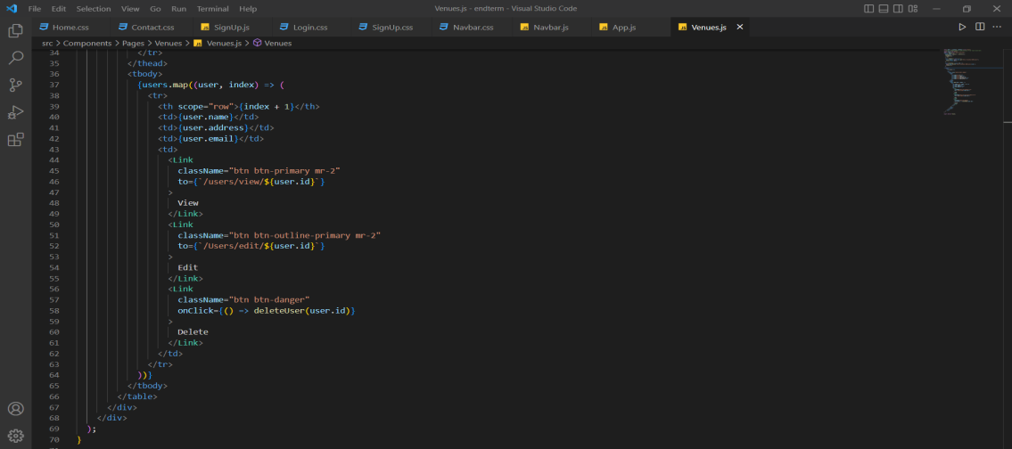
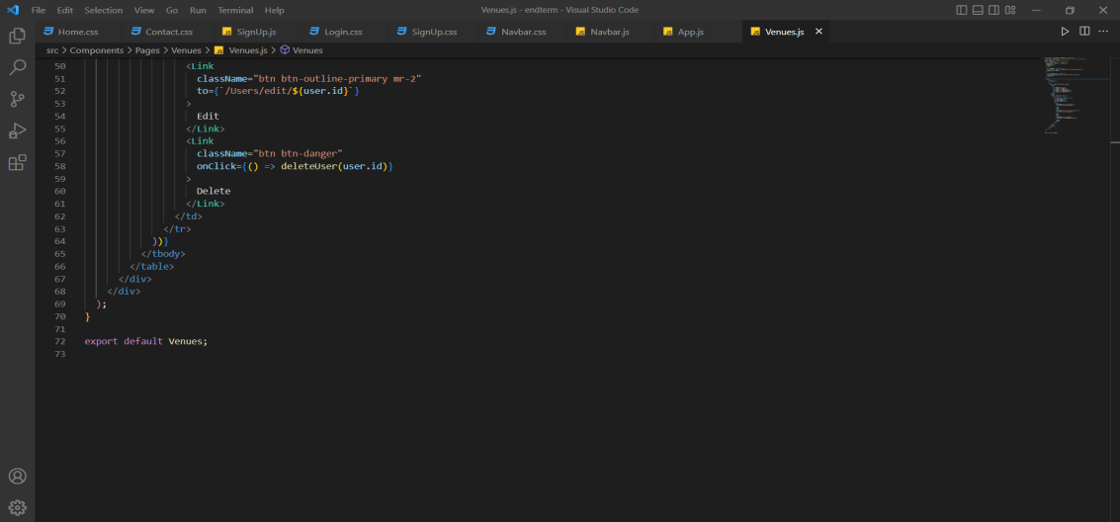
API Code Snippet
Here I tried to develop the project by using API and fetch the data and display it other sections of my project.

Slide 11
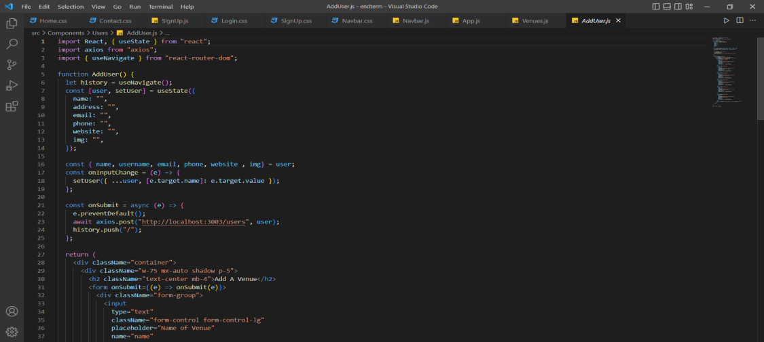
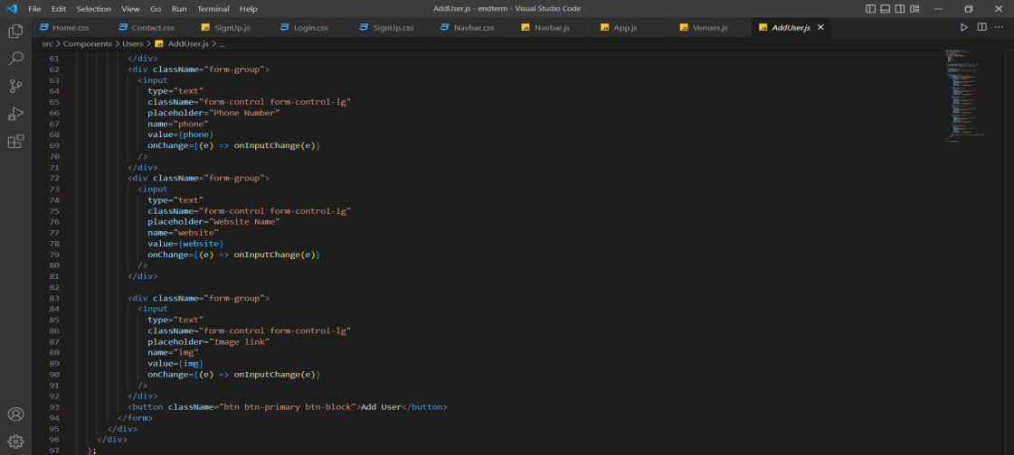
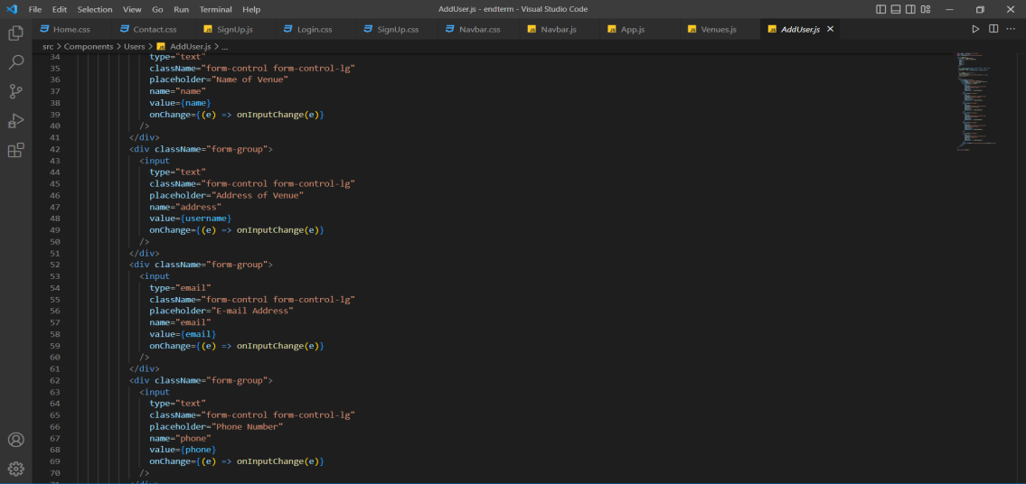
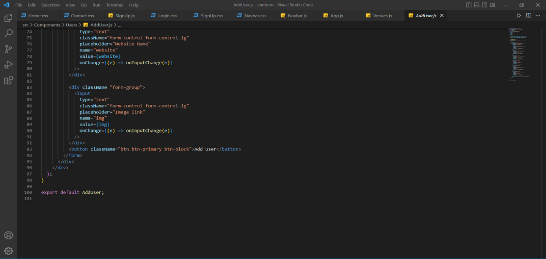
ADD USER Code Snippet
Here I tried to implement add user function by using API and fetch the data.

Slide 12
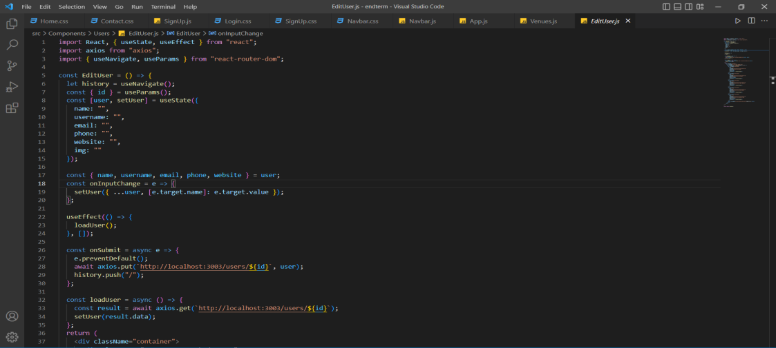
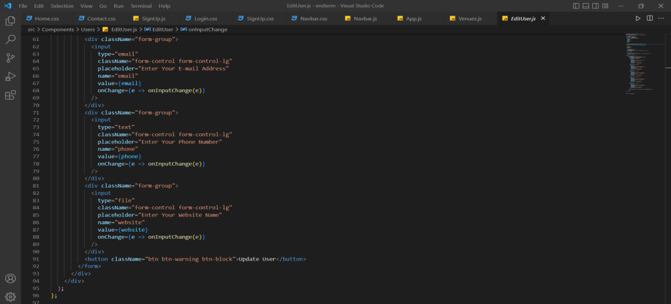
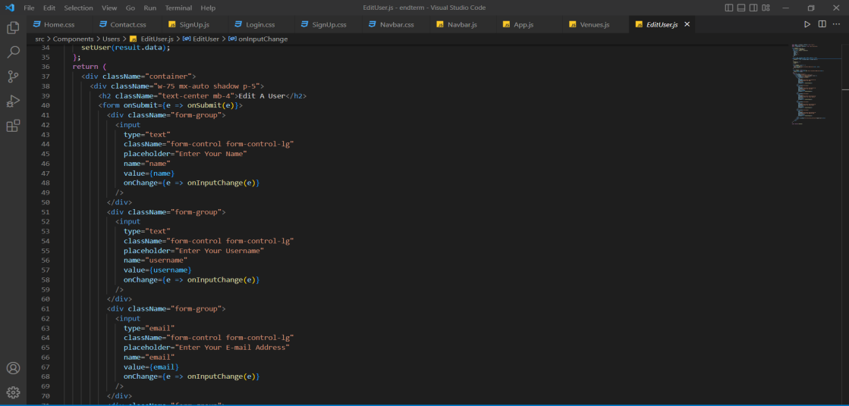
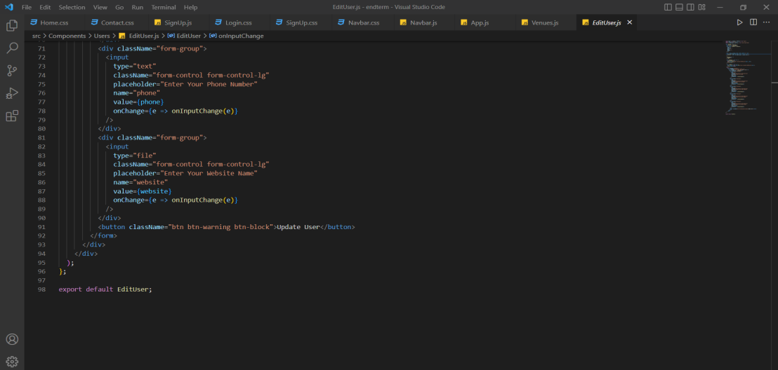
EDIT USER Code Snippet
Here I tried to implement edit user function by using API data and changing the data.

Slide 13
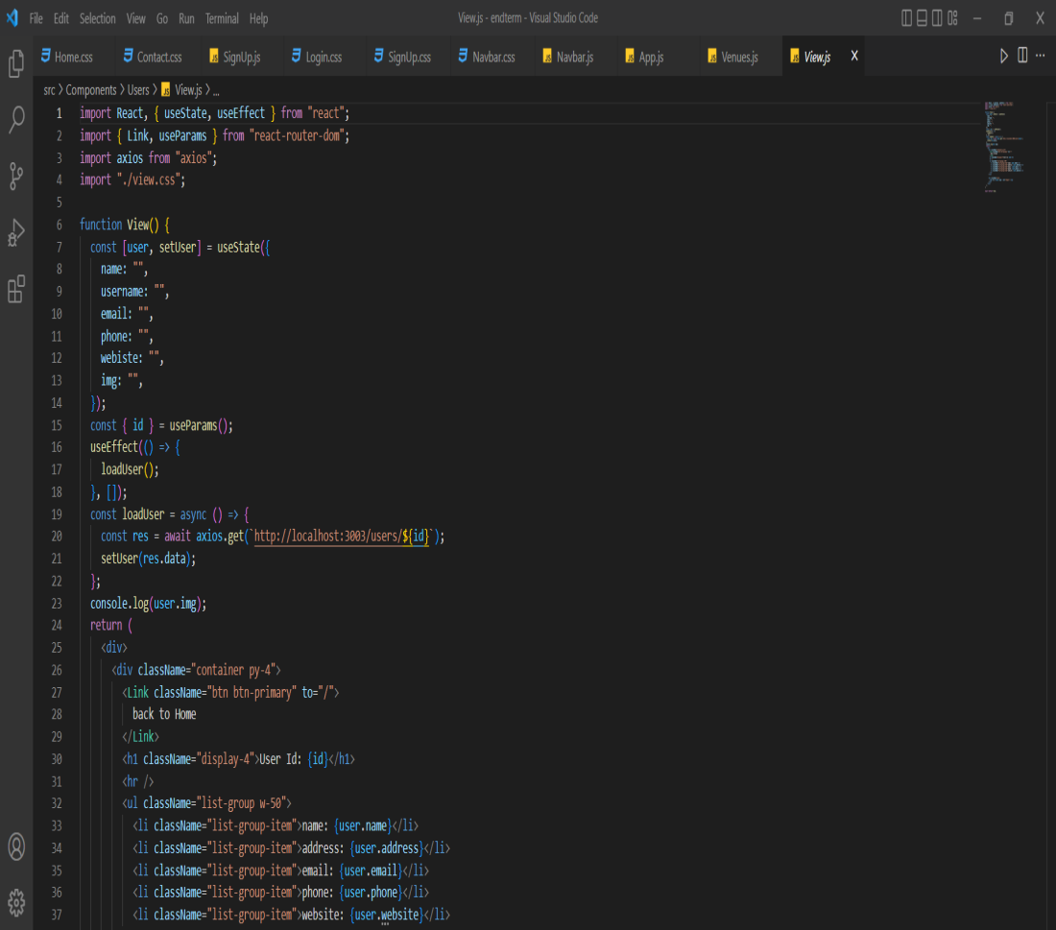
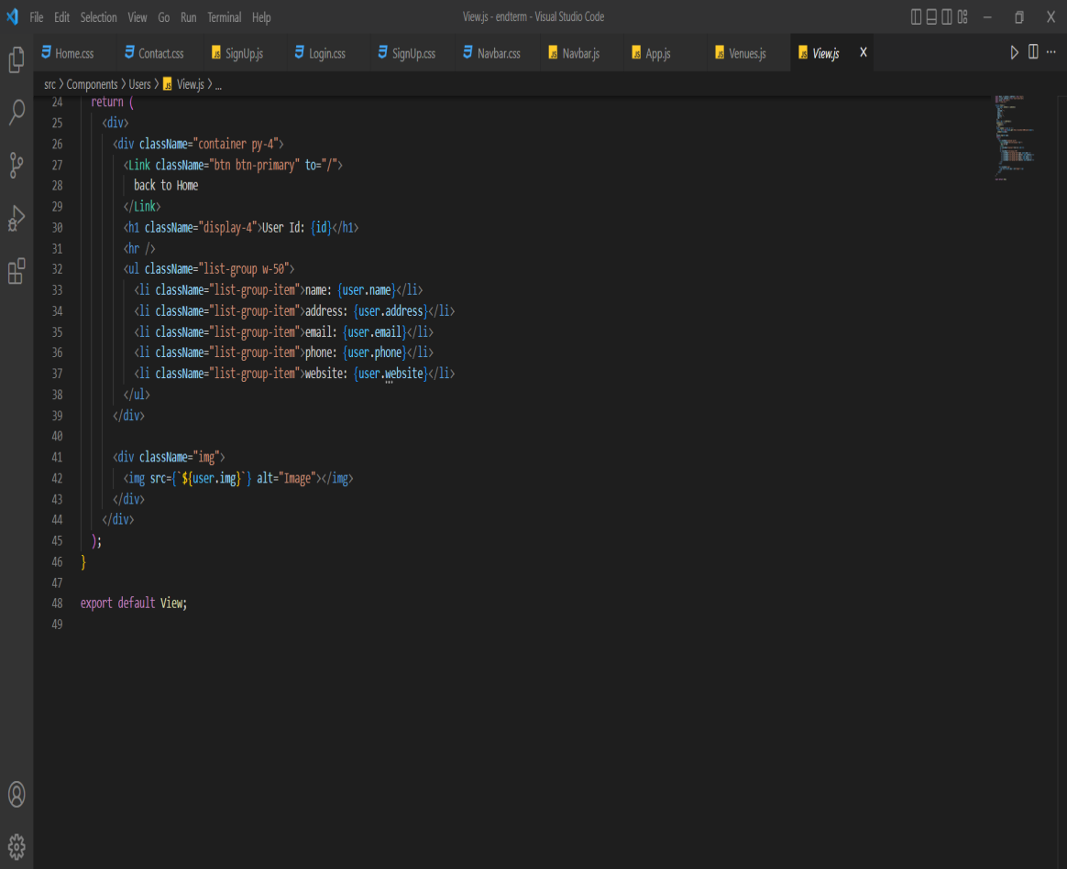
VIEW USER Code Snippet
Here I tried to implement view user function by fetching data from API.

